Slide 1
Green Data Center: The Future of Sustainable IT Infrastructures
Ghazanfar Iqbal
Head of Business Development
ASEAN
Notes:
My Introduction

Slide 2













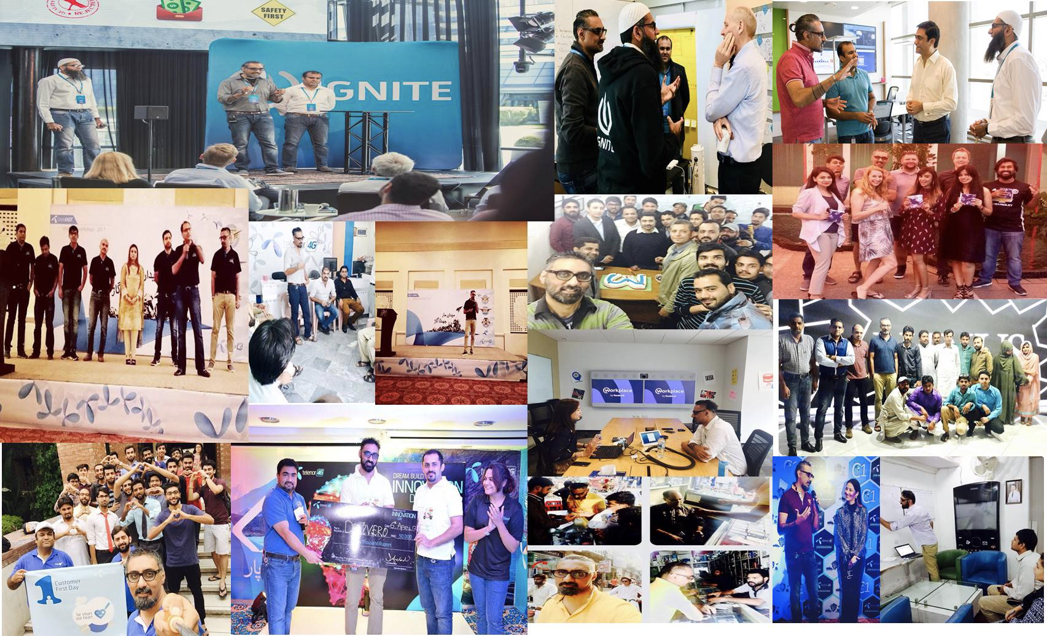



Business Development/Operations/Expansion - 16+ Years
Antler Founder Program Alumni
Co-Founded “Auto Sahulat”
Acumen Fellow
Harvard HPAIR Delegate
Professional Fellow - University of Oklahoma
Mentor at Endeavor, Qureos and NIC
Member Pak US Alumni Network
Cycling
Karachi

Slide 3
Let’s talk Cloud

Slide 4
Enabling tech companies with AWS Cloud
Zero upfront cost
Launch faster
With AWS’s infrastructure-on-demand, startups can pay only for the resources they use instead of investing in servers upfront
Startups can have new IT resources available in just a few clicks, increasing agility
Focus on core business value
Experiment often at lower risk
Startups can focus on growing their business rather than on infrastructure
Being able to deprovision servers as needed enables startups to experiment often and fail fast if an idea doesn’t work
Notes:
Cloud Intro – AWS 2006 and Benefits

Slide 5
Sustainable Journey
Notes:
From Amazon perspective - We find that customers appreciate learning about the efforts we are undertaking to meet our sustainability goals.
In this section, I will share our commitment to sustainability and how we’re approaching and creating initiatives to become more sustainable.

Slide 6



Further and Faster, Together
September 19, 2019
Amazon and Global Optimism announced The Climate Pledge, a commitment to meet the goals of the Paris Agreement 10 years early—and achieve net-zero carbon by 2040. Amazon is a co-founder and first signatory of The Climate Pledge.
Notes:
In September 2019, Amazon co-founded and was first signatory of The Climate Pledge, which calls on companies to commit to reaching net-zero carbon emissions by 2040, 10 years ahead of the Paris Agreement.
Amazon continues to work to reduce emissions across its operations to reach net-zero by 2040, as well as encourage other companies to join in signing the Pledge to accelerate their goals, plans, and programs to address the urgency of climate change.

Slide 7


















































With 400+ signatories from around the world.
Notes:
Since 2019, the Pledge community has grown to include over 400 businesses ranging from large corporations to SMEs, spanning 38 countries and 55 industries. These signatories play a critical role in stimulating investments in the development of low-carbon products and services.
In joining the Pledge community, signatories gain access to other influential professionals in roles at top companies all over the world; educational resources; invites to Passport (the new online community available exclusively to signatories so they can connect with one another); ever-evolving best practice insights and news; as well as opportunities to collaborate with other companies on climate action projects.

Slide 8

AWS and Sustainability
Notes:
Now lets look at aspects of AWS sustainability

Slide 9
A data-driven approach to sustainability strategy, enabled by cloud computing
Sustainability OF
the cloud
Sustainability THROUGH
the cloud
Sustainability IN
the cloud
Delivering a sustainable IT fleet – taking advantage of the cloud and AWS efficiency through migration
Deploying cloud-based solutions and advisory support to accelerate customer sustainability objectives
Optimizing workloads on AWS with the Sustainability pillar of the Well-Architected Framework
Notes:
There are three main parts to sustainability at AWS, OF the cloud, IN the cloud and THROUGH the cloud. We will look further at each.

Slide 10
Sustainability OF the Cloud
Opportunity to reduce impact through migration
Notes:
Sustainability of the cloud refers to the sustainability efforts in our data centers and cloud operations. When migrating to the cloud, customers of all sizes immediately gain the benefit of these efforts.

Slide 11
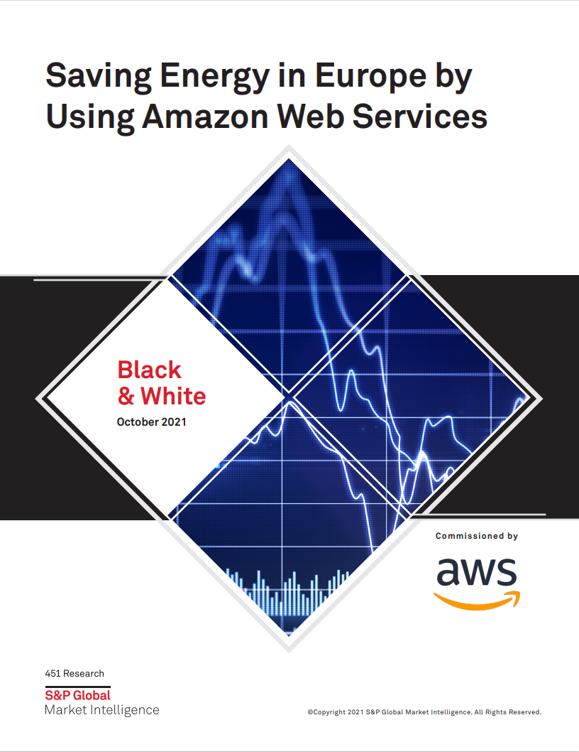

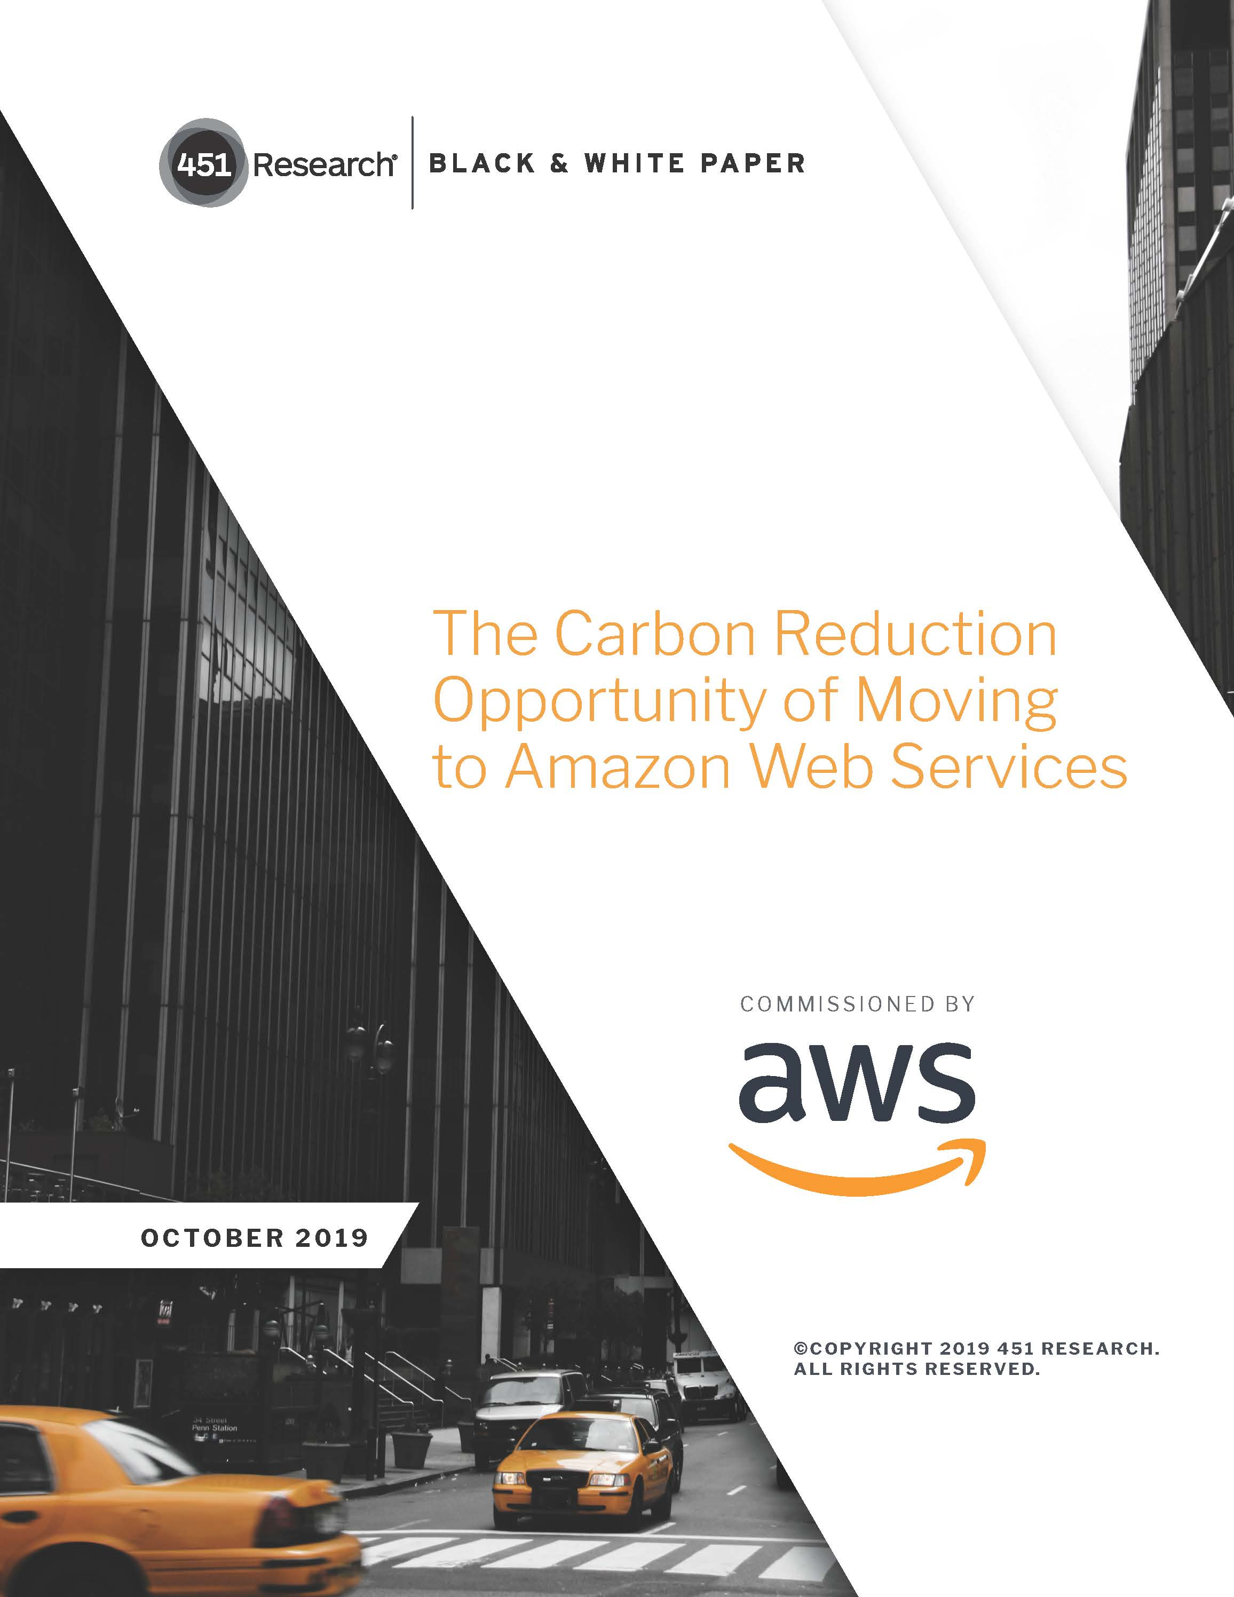
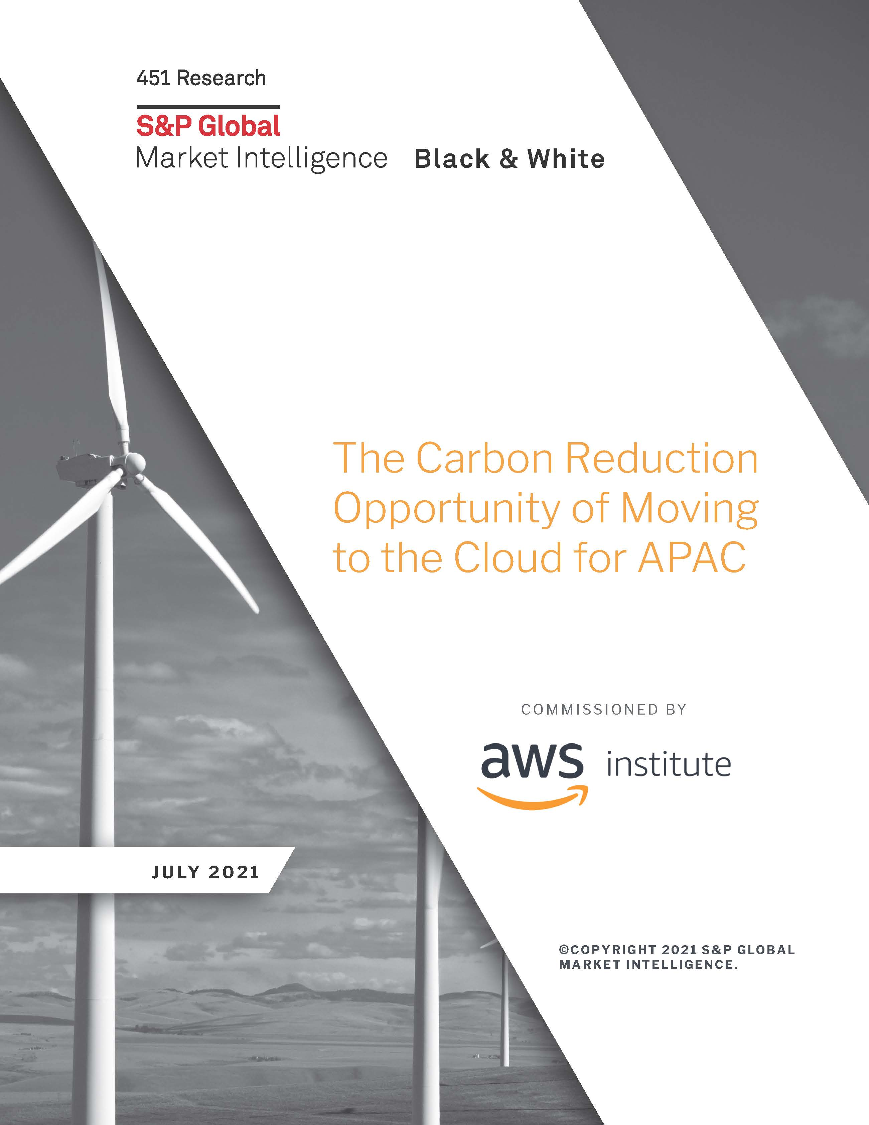
Carbon reduction opportunity
AWS can lower the workload carbon footprint of average on-premises data centers by nearly 80% today and up to 96% once AWS is powered with 100% renewable energy
Europe Up to 5 times more energy efficient
US 3.6 times more energy efficient
Asia Pacific 5 times more energy efficient
Find all the reports on aws.amazon.com/sustainability/resources/
Notes:
According to 451 Research, when compared to surveyed enterprise data centers across several geographic regions, AWS can lower a customer’s carbon footprint by nearly 80% today and up to 96% once AWS is powered with 100% renewable energy, which we are on the path to be by 2025. We now have three 451 research studies that analyzed the efficiency of cloud workloads for the US, Europe and Asia Pacific concluding with the following results:
AWS infrastructure is 3.6 times more energy efficient than the median of U.S. enterprise data centers surveyed.
AWS infrastructure is up to 5 times more energy efficient than the average European enterprise data center.
AWS infrastructure is 5 times more energy efficient than the average on-premises data centers in the Asia Pacific region.
Why is AWS more efficient?
The energy savings result from the higher energy efficiency of both the servers and data center facilities. This is because AWS pays great attention to power optimization, integrating the very latest components. These servers run at higher utilisation levels, and leverage our ability to share and dynamically allocate resources among multiple customers. At the facility level, designs that use less energy for both cooling and power distribution boost efficiency our owned and leased data centre sites. All of this translates into considerably less energy used to perform the same unit of work
Additionally, we’re focused on delivering IT services at scale: Maximizing energy efficiency (and thereby reducing power costs) can have a direct impact on the bottom line. So we have an incentive to make the entire technical organization work together, from design to operations and from servers to data centers, to improve energy efficiency. This includes operating servers at a higher utilization rate and designing facilities to reduce energy and water consumption. By contrast, enterprise infrastructure tends to be fragmented across disciplines (server, storage, networks, facilities management, real estate, etc.), with efficiency initiatives that are narrower in focus and harder to scale.
If they want methodology each report is slightly different in terms of how many companies were surveyed, see methodology on first slide for each region.

Slide 12
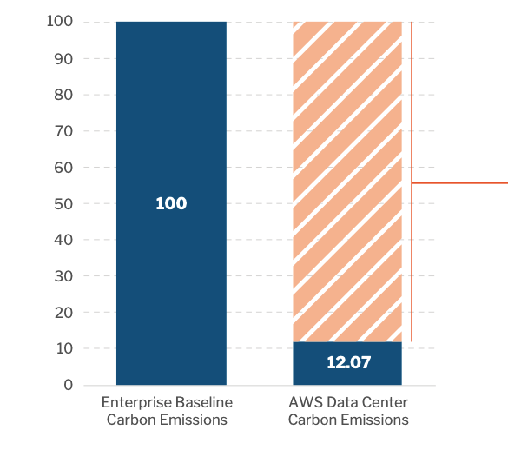
U.S.: Carbon reduction opportunity
AWS 3.6 times more energy efficient than the median of U.S. enterprise data centers surveyed
61% of carbon reduction is attributable to more efficient servers and higher server utilization
11% of carbon reduction is attributable to more efficient data center facilities
17% of carbon reduction is attributable to reduced electricity consumption and renewable energy usage
Carbon efficiency of AWS infrastructure compared to surveyed U.S. enterprises
Source: 451 Research, The Carbon Reduction Opportunity of Moving to Amazon Web Services, 2019
© 2023, Amazon Web Services, Inc. or its affiliates. All rights reserved.
Notes:
Enterprises use public cloud infrastructure for various reasons, but faster time-to-market and the ability to flexibly scale resources to track workload demand are the top two drivers, according to 451 Research’s Voice of the Enterprise survey on cloud, hosting and managed services¹ . And importantly, moving workloads to public cloud infrastructure also presents enterprises with the opportunity to dramatically reduce the environmental footprint of their IT operations.
Our results show that AWS’s infrastructure is 3.6 times more energy efficient than the median of the surveyed US enterprise data centers. AWS’s scale enables high resource usage, and its global cloud infrastructure is built using Amazon’s own custom hardware, purpose-built and optimized for workloads run by AWS customers. AWS achieves lower energy use in its data centers through innovation, such as designing cooling systems that reduce energy and water use, and using real-time sensor data to adapt to changing weather conditions.
Quoting from the 451 report, ”When we factor in the carbon intensity of consumed electricity and renewable energy purchases, which reduce associated carbon emissions, AWS performs the same task with an 88% lower carbon footprint."
Methodology: We surveyed senior stakeholders at over 300 companies – typically with the titles of CIO, CTO, IT director and data center manager – seeking information about their infrastructure operations at their largest US data center location (on-premises or colocation). Participating companies came from a broad cross section of the US economy representing over 20 sectors, such as IT and telecommunications, media and entertainment, financial services, manufacturing and healthcare.
US Report link: https://sustainability.aboutamazon.com/carbon-reduction-aws.pdf

Slide 13
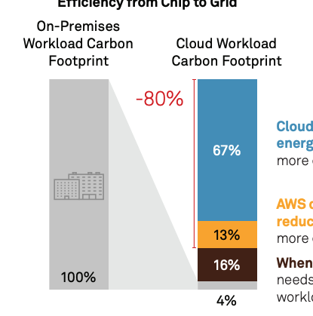
Europe: Carbon reduction opportunity
AWS up to 5 times more energy efficient than typical EU enterprise infrastructure
Cloud servers are responsible for the largest energy reduction, more than 67%, due to being more energy-efficient and more highly utilized
67%
AWS data center facilities account for another 13% reduction by using power and cooling systems that are more efficient, bringing energy savings to 80%
13%
As AWS continues to increase its renewable energy globally, that could further reduce the carbon footprint of workloads moved to cloud by up to 16%
16%
Efficiency from Chip to Grid
Source: 451 Research, a part of S&P Global Market Intelligence, Saving Energy in Europe by Using Amazon Web Services, 2021
© 2023, Amazon Web Services, Inc. or its affiliates. All rights reserved.
Notes:
Enterprises use public cloud infrastructure for various reasons, but faster time-to-market and the ability to flexibly scale resources to track workload demand are the top two drivers, according to 451 Research’s Voice of the Enterprise survey on cloud, hosting and managed services. ¹ And importantly, moving workloads to public cloud infrastructure also presents enterprises with the opportunity to dramatically reduce the environmental footprint of their IT operations. Overall, the AWS Cloud infrastructure is up to five times more energy efficient than typical EU enterprise infrastructure.
AWS’s scale enables high resource usage, and its global cloud infrastructure is built using Amazon’s own custom hardware, purpose-built and optimized for workloads run by AWS customers. AWS achieves lower energy use in its data centers through innovation, such as designing cooling systems that reduce energy and water use, and using real-time sensor data to adapt to changing weather conditions.
Results show that companies in Europe can reduce their energy use by almost 80% by moving their compute workloads out of on-premises data centers to AWS. Businesses could potentially reduce carbon emissions of an average workload by up to 96% when AWS reaches its goal of purchasing 100% of its energy from renewable sources, which we are on the path to do by 2025 – 5 years ahead of our goal.
Methodology: 451 Research began with a survey of 308 enterprises across France, Germany, Ireland, Spain and Sweden from a variety of industries. We asked EU survey respondents a series of questions about their server infrastructure and operations. We used these responses in our model to establish profiles of enterprise server infrastructure in the EU, focusing on two main measures of energy efficiency: the age of servers in the installed server base (as servers have become more efficient over time) and their utilization rates, which also impact energy efficiency. Utilizing these survey results, other 451 Research and third-party industry data on cloud service operations, we devised and populated an energy-efficiency model that offers a ‘chip to grid’ view. At the core of this model is a measure of the amount of work performed for the total energy used by the data center infrastructure, covering both data center facility-level power usage effectiveness (PUE) and server-level energy efficiency
European report link:
https://assets.aboutamazon.com/b0/3e/b0fc6b8a4a85b38ac65a3fbc584c/11061-aws-451research-advisory-bw-cloudefficiency-eu-2021-r5-final-corrected-data.pdf

Slide 14
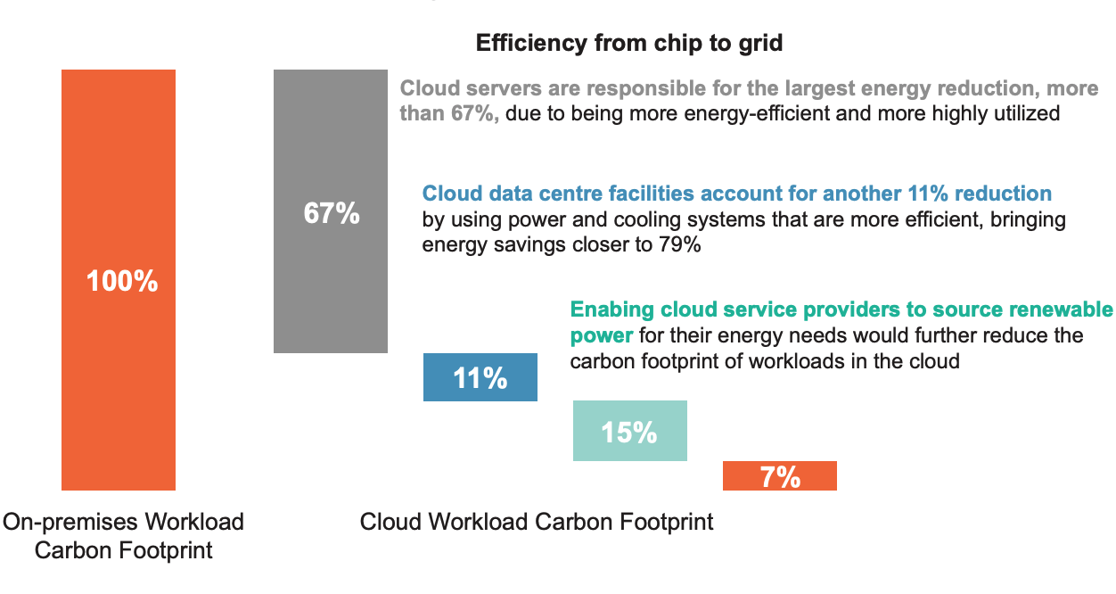
Asia: Carbon reduction opportunity
AWS is 5 times more energy efficient than the average on-premises data centers in the Asia Pacific region
Carbon reduction potential of Cloud Infrastructure compared with surveyed APAC Enterprises and Public Sector Organizations
Source: 451 Research/S&P Global Market Intelligence after The Carbon Reduction Opportunity of Moving to the Cloud for APAC, 2021
Organizations across Japan, South Korea, Singapore, Australia, and India were surveyed
© 2023, Amazon Web Services, Inc. or its affiliates. All rights reserved.
Notes:
Moving computing workloads from on-premises data centers to the cloud can improve energy efficiency for companies in the Asia Pacific Region (APAC) and reduce their carbon footprint by more than 78%, according to a new study of companies and public sector organizations by 451 Research commissioned by Amazon.
451 Research found that on-premises data centers across APAC typically have a server utilization rate of just under 15%, whereas cloud-based data centers using servers powered by the latest processors and with utilization of 50% or more achieve peak efficiency. Given this difference in utilization, cloud servers are able to achieve energy savings of more than 67% compared to typical on-premises servers, according to the report. The research also found that when compared to on-premises data centers, cloud-based data centers offer an additional potential energy savings of more than 11% due to their highly energy-efficient power and cooling systems.
Methodology: Surveyed senior stakeholders at over 500 organizations from a variety of industries in Japan, South Korea, Singapore, Australia, and India—including over 100 public sector organizations and enterprises with annual revenue between USD $10m and $1bn in each country. These survey results, along with analysis and third-party industry data, were used to model a ‘chip to grid’ view of efficiency that estimated the energy used by typical workloads in on-premises (self-owned and operated) servers and data centers on average. This was compared with an estimate of energy used by hyperscale5 cloud facilities in order to understand whether enterprises and public sector organizations across the APAC region could reduce energy consumption — and their related carbon footprint — by moving workloads from on-premises data center infrastructure to the cloud.
APAC report link: https://assets.aboutamazon.com/2b/73/4f5c2c884e1b8461b2f7fe4ea138/aws451researchapacjuly2021.pdf

Slide 15
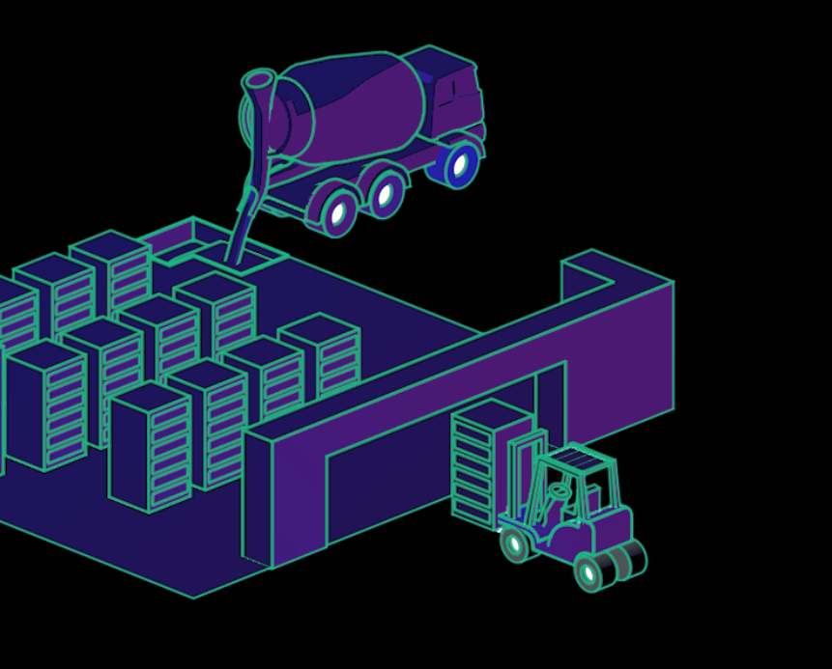
Reducing carbon emissions across our global operations
43 data centers constructed using either or both lower-carbon concrete and steel
Backup generators at data centers powered with renewable fuels, reducing emissions by up to 90%
Lower lifecycle impacts of silicon-based devices from materials to manufacturing
Electricity consumed in 19 AWS Regions was attributed to 100% renewable energy
Notes:
AWS is working toward net zero by reducing carbon emissions across our global operations and supply chain. One way we’re doing this is by reducing the embodied carbon associated with steel and concrete used to build our data centers. AWS has 43 data centers across the globe that have been constructed with either or both lower-carbon concrete and steel. So far announced in this year, we've saved more than 22,000 tons of carbon dioxide equivalent (tCO2e) from the construction of 27 data centers using lower-carbon steel and concrete. Concrete: Our design standards now require concrete with a 20% reduction in embodied carbon for new US data centers and we’re expanding this requirement globally. In Northern Virginia, AWS worked with a supplier to procure low-carbon ECOPact concrete for several data centers, which reduces carbon emissions by nearly 40%.
Steel: Instead of using steel from blast oxygen furnaces that burn coal or gas, we are moving to steel from electric-arc furnaces, which use higher amounts of scrap steel, up to 100%, and can create steel using renewable energy. This can result in 5X as less carbon than traditional steel production. Renewable fuel: We are also using cleaner fuels to power our backup generators instead of relying on fossil-fuel based diesel. This year, we started transitioning to hydrotreated vegetable oil (HVO) to power backup generators at our data center sites in Europe, starting with Ireland and Sweden. HVO can reduce greenhouse gas emissions by up to 90% over the fuel’s lifecycle when compared with fossil diesel. Embodied carbon of hardware: We’re reducing the embodied carbon associated with the manufacturing of AWS hardware, including silicon-based devices, like processors and solid-state drives. We are working with suppliers to address the full lifecycle of emissions, from raw materials extraction to chip manufacturing, by working with suppliers to improve their energy efficiency and powering operations with 100% renewable energy.
AWS Regions consuming 100% renewable energy include:
U.S. East (Northern Virginia)
GovCloud (U.S. East)
U.S. East (Ohio)
U.S. West (Oregon)
GovCloud (U.S. West)
U.S. West (Northern California)
Canada (Central)
Europe (Ireland)
Europe (Frankfurt)
Europe (London)
Europe (Milan)
Europe (Paris)
Europe (Stockholm)
Europe (Spain)
Europe (Zurich)
Asia-Pacific (Mumbai)
Asia-Pacific (Hyderabad)
China (Beijing)
China (Ningxia)

Slide 16

Embracing a circular economy
Design. We eliminate excess materials, increase recycled and biobased content, and plan for reuse from the start.
Operate. We extended the life of our servers from 4 years to 5 and our networking equipment from 5 years to 6.
Recover. Our reverse logistics hubs test, repair, and recirculate equipment back to data centers or to be sold for reuse by third parties.
Notes:
AWS embraces three circular economy principles for our server racks, which allows us to keep resources at their highest value for as long as possible. This reduces waste generation from our global operations and decreases the use of raw materials and carbon emissions across our supply chain.
Design. When it comes to design, we focus on eliminating excess materials, increasing post-consumer recycled content, and planning for repair, reuse, and recycling from the start.
Operate. We use our equipment for as long as operationally efficient. AWS has extended the life of our servers from four years to five and our networking equipment from five years to six.
Recover. AWS uses a network of Reverse Logistics hubs that test, repair, and recirculate non-media storage equipment back to data centers, or to be sold for reuse by third parties.

Slide 17
Sustainability THROUGH the Cloud Leverage AWS technologies and data services to solve sustainability challenges
Notes:
Depending on your sustainability requirements, we can work with you in a variety of ways. Either through our sustainability experts, partners, or sharing how AWS technologies are being build out for sustainability use cases.

Slide 18
Sustainability drives business growth
72% of respondents agree it is impossible to meet their sustainability goals without using technology,
yet only 21% agree they are effective in using technology to support their sustainability strategy
-Results from an Incisiv survey in partnership with AWS
Notes:
In fact, an Accenture study called out that new value is increasingly being found at the intersection of digital technologies and sustainability. Digital transformation defined the business landscape in the 2010s. The Accenture research indicates that the next decade of business change will be defined by the sustainability transition. The companies leveraging it—we call them Twin Transformers—are 2.5x more likely to be among tomorrow’s strongest-performing businesses than others. With these twin engines of growth, they’re 2.5x more likely to outperform their peers.
Twin Transformer companies foster ecosystem-based business models driven by sustainability and enabled by technology. Considering sustainability as a business opportunity as well as a response to societal challenge. This is an opportunity to synchronize existing or future digital initiatives with sustainability efforts and goals.
Report called: The European double up: A twin strategy that will strengthen competitiveness
https://www.accenture.com/us-en/blogs/technology-innovation/tech-sustainability-leadership

Slide 19


AWS solutions approach
Customer Use Case Identification & Prioritization
Carbon Accounting
ESG Reporting
Sustainable IT
Energy Optimization
Sustainable Buildings
Value Chain Transparency
AWS Solutions Library
AWS Service
Partner Solution
AWS Solution
Guidance
Software, SaaS, or managed services from reviewed AWS partners
Ready-to-deploy solutions assembling AWS offerings, code, and configurations
Prescriptive architectural diagrams, sample code, and technical content
Purpose-built cloud products
Notes:
Almost all industries have a set of shared challenges. This generally includes things like facilities or building management, design or optimization, and carbon tracking/footprinting. To help with this, customers must first understand the impact of their facilities, operations, or supply chain. Many customers use AWS services for ingestion, aggregation, and transformation of their real-world data. Once the data is collected and customers understand their relative impact, this data can be used to form models, which act as the basis for optimization.
We see a lot of companies starting with these topics.
So how can AWS help?
Based on what we are hearing from industrial customers we have identified six priority use cases. We understand that Customers prefer off-the-shelf deployments, or customizable architectures. To cater these different customer personas we have the AWS Solutions Library -this is a dedicated space where customers can easily browse Vetted solutions built by AWS and AWS Partners and guidance for builders to quickly get started.
Beyond these purpose-built services we AWS Solutions help you build faster with Cloud Formation templates, reference architectures, GitHub repositories, and deployment guides.
How do we achieve this?
Access to a network of partners
Incubated POCs and bespoke solutions for sustainable acceleration.
Innovation Programs – Think Big, Work Backwards
Prototype Builds & Technical Proof-of-Concept
Proof-of-Value & Strategic Business Advisory
Solutions architects, engineers, business advisors, and domain experts working in tandem to accelerate sustainability innovation and transformation with AWS technology.
Prioritized Use Cases

Slide 20

Case study: Bayer Crop Science
“
We are very excited to launch a solution to help transform the food and agriculture value chain by paving the way for a more resilient, regenerative and net-zero carbon future.
Leo Bastos
Global Commercial Ecosystems Lead,
Bayer Crop Science
AWS built the digital carbon footprint measurement solution
Carbon emissions data tracked for farmed corn from farm to processor, and then to final purchaser
”
Supply chain digital transparency for Scope 3 emissions
Notes:
Bayer, a global enterprise with core competencies in the life science fields of health care and nutrition, is also committed to drive sustainable development and generate a positive impact with its businesses. Bayer came to AWS to discuss how to track carbon emissions through the value chain from farmer to end purchaser of agricultural goods. Companies purchasing crops for downstream processing have limited visibility into the carbon footprint of their supply chain (categorized as Scope 3 emissions by the Greenhouse Gas Protocol)
With support from AWS and the Digital Innovation Program, Bayer worked backwards to define a tool to trace the carbon intensity of agriproducts moving through the supply chain, unifying the carbon data from seed to processing. This solution helps companies make informed purchasing and sustainability investment decisions, offer differentiated products at the point of sale, and aid regulatory and climate target reporting.
We can share the AWS technical blog, customer video, and Bayer press release.
AWS Technical blog: https://aws.amazon.com/blogs/industries/bayer-carbonview-tracing-product-carbon-footprint-pcf-through-the-agriculture-supply-chain/
Bayer customer video: https://www.youtube.com/watch?v=mRDoiCZim00
Bayer press release: https://www.bayer.com/en/us/bayer-project-carbonview

Slide 21
Sustainability requires innovation
Identify
Innovate
Implement
Identify needs Start with the customer
Discover solutions Create PR, FAQs, visuals
Finalize solution Continually revisit PR, FAQs, visuals
Generate ideas Brainstorm
Select solution
Production & distribution
Evaluate opportunity Answer the 5 questions
Refine solution Iterate
Transition to operations & scale
Notes:
Commitments to sustainability goals are driving companies to use it as a competitive differentiator. If you want to reimagine your products or services we can help through that process – from helping you identify what customers want through our working backwards process or to actually building out industry specific new solutions with your development teams
The AWS Digital Innovation group can take you through a Working Backwards process with sustainability experts, they can also run discovery workshops.
Or alternatively, we can co-develop with you through the AWS Industry Products team (formerly known as Outcome Driven Engineering) to innovate around sustainability targets and plans. Industry Products brings multi-disciplinary field teams, service organizations and expertise to sustainability topics. They collaborate with customers to build industry specific products in new areas that address sustainability.
Digital Innovation and Industry Products teams are designed to help business leaders bring ideas to market faster.

Slide 22
Sustainability IN the cloud
Optimizing for sustainability Sustainable Pillar of the Well-Architected Framework Customer carbon footprint tool
Notes:
When working with large amounts of data, we do want to do so efficiently. We have ways to help you optimize your newly moved AND your existing cloud workloads for sustainability. Let’s talk about that now.

Slide 23
Sustainability pillar of the Well-Architected Framework
Business need Time to value for feature delivery of sustainable products
Operational excellence
Security
Reliability
Performance efficiency
Cost optimization
Sustainability
Sustainability
The six well-architected pillars
Notes:
AWS Well-Architected helps cloud architects build secure, high-performing, resilient, and efficient infrastructure for a variety of applications and workloads. We previously had five pillars in the AWS Well-Architected framework - operational excellence, security, reliability, performance efficiency, cost optimization, and we then created a sustainability pillar. AWS Well-Architected provides a consistent approach for customers and partners to evaluate architectures and implement scalable designs.
The sustainability pillar enhances the Framework to provide a way for you to consistently measure architectures against sustainability best practices and identify areas for improvement, with the focus being on reducing the energy consumption of your AWS workloads. It contains questions aimed at helping customers evaluate the design, architecture, and implementation of their workloads to reduce their energy consumption and improve their efficiency. Much more than a simple checklist, it’s designed to be a tool that customers can use to track their progress toward policies and best practices that support a more sustainable future.
https://aws.amazon.com/architecture/well-architected/?wa-lens-whitepapers

Slide 24
Focus domains of AWS Well-Architected Sustainability pillar
Region selection
Alignment to demand
Data
Hardware & services
Software & architecture
Process & culture
Notes:
These are the 6 main focus domains in Sustainability pillar:
- Region selection
- User behavior
- Software and architecture
- Hardware
Data-
Dev & deployment process

Slide 25

Graviton, Inferentia, and Trainium
Graviton3-based Elastic Compute Cloud instances use up to 60% less energy than comparable Amazon EC2 instances
Models built on Trainium result in energy-consumption reductions of up to 29% versus comparable instances
Our Inferentia2 machine learning chip is up to 50% more performance per watt
Notes:
The AWS Global Infrastructure is built on AWS’s own hardware, which includes purpose-built servers, routers, and processors, optimized for workloads run by AWS customers. We have improved power efficiency and availability by removing the central Uninterruptible Power Supply (UPS) from our data center design and integrating small battery packs and custom power supplies into our racks. These changes combined reduce energy conversion loss by about 35%.
One example of how we build hardware with sustainability in mind is Graviton3, which is our third generation ARM-based processor. Graviton3-based Amazon Elastic Compute Cloud (Amazon EC2) instances use up to 60% less energy for the same performance than comparable Amazon EC2 instances.
In 2022, we launched AWS Trainium, a high-performance machine learning chip designed to reduce the time and cost of training generative AI models—cutting training time for some models from months to hours. This, in turn, means building new models requires less money and power, with potential cost savings of up to 50% and energy-consumption reductions of up to 29%, versus comparable instances. Inferentia is our most power-efficient machine learning inference chip.
Our Inferentia2 machine learning chip is up to 50% more performance per watt and can reduce costs by up to 40% against comparable instances.
With the world’s increase in demand for compute and machine learning becoming more pervasive, continually innovating at the chip level is critical to ensuring that we can sustainably power the workloads of the future so we are continually improving the power efficiency of Graviton and Inferentia.

Slide 26

Optimize for sustainability: Quick wins
Improve energy efficiency by switching to Graviton-based instances
Choose serverless when possible
Integrate AWS Instance Scheduler to shut down and terminate when not in use
Use AWS Compute Optimizer for right-sizing recommendations of workloads
Notes:
The core themes of optimization for sustainability are to maximize utilization and reducing waste or duplication. Most customers start with relatively easy things to accomplish. These typically include things like using the AWS Instance Scheduler to turn off compute when it will not be used or comparing cost and utilization reports to find hot spots to reduce utilization.
If you’d like to find out more I can bring in one of our Sustainability Solution Architects to discuss how to further optimize your workloads for sustainability.

Slide 27
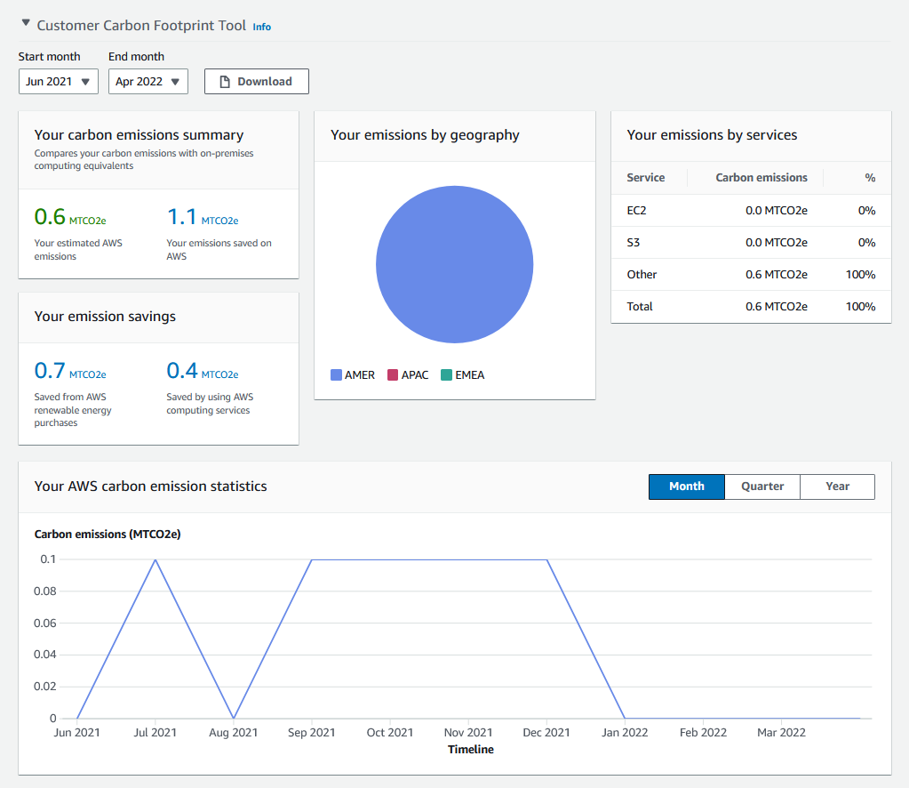
AWS customer carbon footprint tool
Calculate carbon emissions generated from your AWS workloads
Understand historical carbon footprint and review changes in emissions over time
Forecast changes as Amazon stays on a path to 100% renewable energy by 2025
Notes:
We also provide customers with the AWS customer carbon footprint tool, to help you understand the carbon footprint of workloads running on AWS, and support your reporting.
Benefits of the tool are: Calculated Carbon Footprint Estimates The AWS customer carbon footprint tool automatically calculates your carbon footprint from your entire portfolio of services and regions and delivers you a monthly summary report with insights into your emissions generation by geography and top service. Trend Analysis Understand your historical carbon footprint and review changes in your emissions over time. For users of AWS Organizations, your management account view will include emissions for all member accounts in your Organization. Forecasted Future Emissions Assess the impact on your emissions as your current AWS usage evolves and once AWS meets its goal to be powered by 100% renewable energy, a target the company is on a path to achieve by 2025.
Multiple charts are included to help you track emerging trends in your footprint, plan future deployment strategies, and include as part of your broader sustainability reporting initiatives.

Slide 28
What are the next steps in customer’s journey?
Migrate and take advantage of AWS sustainability investments and efficiencies
“At Amazon, we thrive on pushing the boundaries of what’s possible. We are taking the same tenacity we use to invent and problem solve for our customers and applying it to how we help address some of the world’s biggest challenges.”
Kara Hurst
Vice President, Worldwide Sustainability, Amazon
Leverage AWS services and expertise to build for sustainability
Optimize your workloads with the Sustainability Pillar of the Well-Architected framework
Notes:
Depending on the needs, we can work with customers in a variety of ways. Either through our sustainability practice, partners, or share how AWS technologies are being build out for sustainability use cases.

Slide 29
Thank you!
For more case studies and other AWS sustainability news visit our website.
aws.amazon.com/sustainability

